Slide 1






Lightning Talk Cloud & Data centers & Irish Tech HUB
Tünde Csapó
Green Fox Academy / Fulvipes / Secret
tundecsapo
Tunde Csapo

Slide 2
< AGENDA >
Data centers
Benefits of using cloud
Irish tech HUB

Slide 3
< data center>
“A data center is a facility composed of networked computers and storage that businesses or other organizations use to organize, process, store and disseminate large amounts of data. A business typically relies heavily upon the applications, services and data contained within a data center, making it a focal point and critical asset for everyday operations.”

Slide 4
< data center elements>
IT equipment:
servers,
storage subsystems,
networking switches,
routers,
firewalls,
cabling,
physical racks
Infrastructure:
supplemental power subsystems,
electrical switching,
uninterruptable power supplies,
backup generators,
ventilation,
data center cooling systems,
network carrier (telco) connectivity
Other:
Facility – the location and the usable space
Physical Security Systems – biometrics and video surveillance systems.
Operations staff – to monitor operations and maintain IT and infrastructural equipment around the clock.

Slide 5
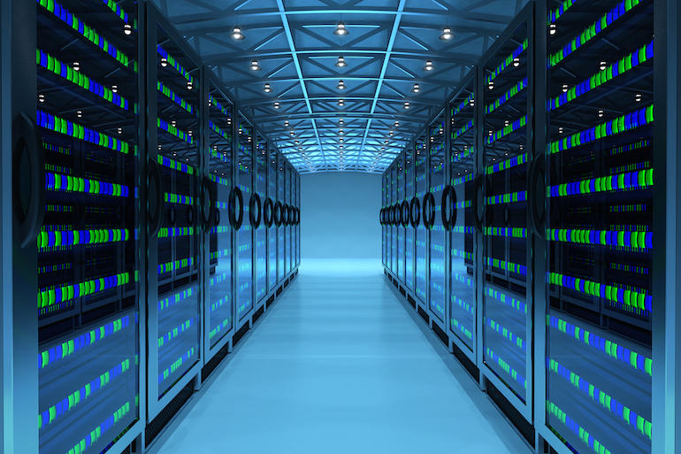

Slide 6
< CRTITICAL factors>
1. Environmental factors
(temperature, humidity, fire suppression, air flow, seismic and meteorological stability, access to roads and airports)
2. Security
3. Accountability
4. Policies & Monitoring
5. Scalability
6. Documentation
7. Organization

Slide 7
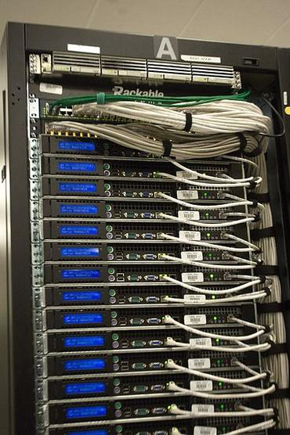
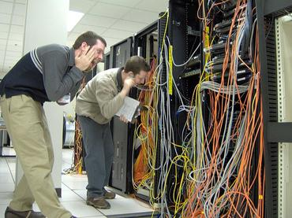
< Organization >

Slide 8
< Cost of Ownership >
Hardware
Networking and bandwidth expenditures
Cost of power (including redundant systems and their maintenance)
Cooling costs
Physical security
Ongoing maintenance
Software Investment
Resource Management
Utilization
initial capital expenditures vs. ongoing expenses

Slide 9
< Types of data centers >
enterprise (or “internal”) vs. internet-facing data centers
or HYBRID CLOUD APPROACH
Benefits
Start small and expand as needed seamlessly and transparently
Providing dynamic environment

Slide 10

< DATA CENTERS >

Slide 11
< Virtualization >
“Virtualization is adding a level of automation, user self-service and billing/chargeback to data center administration. The goal is to allow individual users to provision workloads and other computing resources on-demand, without IT administrative intervention.”

Slide 12
< CLOUD COMPUTING >
Delivery of hosted services over the internet.
Cloud computing enables companies to consume a compute resource, such as a virtual machine (VM), storage or an application, as a utility -- just like electricity -- through a network connection rather than having to build and maintain computing infrastructures in house.

Slide 13
< Advantages of Cloud Computing>
Regulatory compliant
Access to additional functionality
Reduced Downtime
Advanced Security
Disaster Recovery
'Accident' Proof

Slide 14
< Advantages of Cloud Computing>
Cost savings
Security
Flexibility
Mobility
Insight
Increased collaboration

Slide 15
< Advantages of Cloud Computing>
Quality control
Disaster recovery
Loss prevention
Automatic software updates
Competitive edge
Sustainability

Slide 16

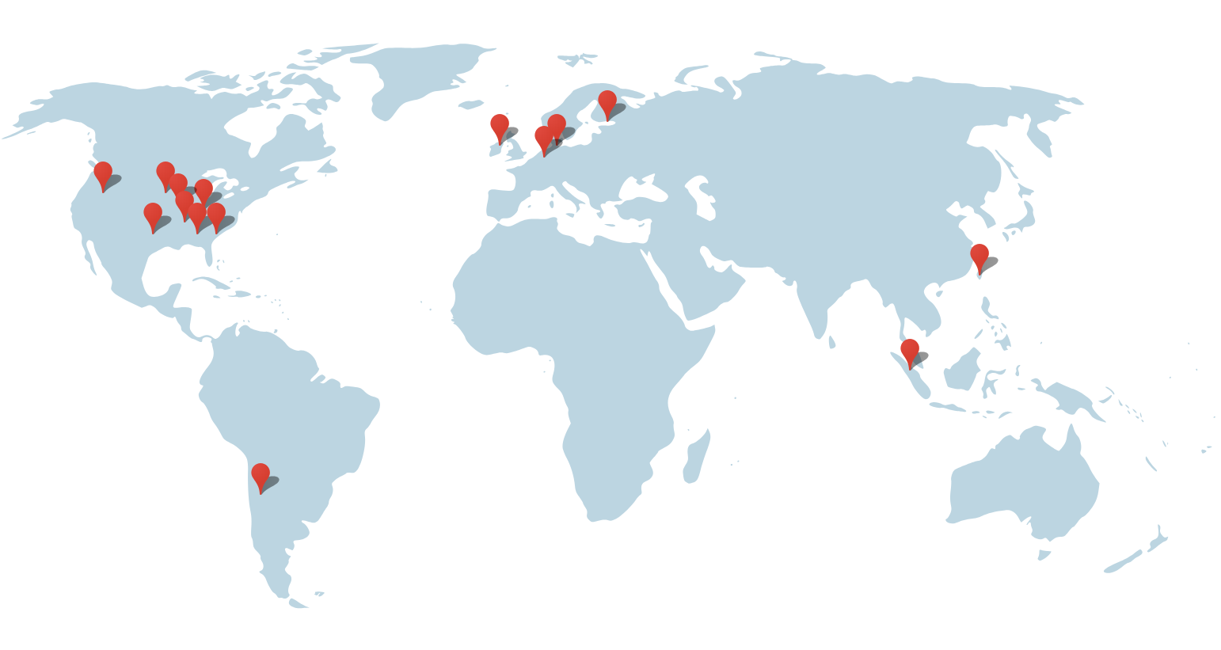
< DATA CENTERS >
Americas
Berkeley County, South Carolina
Council Bluffs, Iowa
Douglas County, Georgia
Jackson County, Alabama
Lenoir, North Carolina
Mayes County, Oklahoma
Montgomery County, Tennessee
Quilicura, Chile
The Dalles, Oregon
Asia
Changhua County, Taiwan
Singapore
Europe
Dublin, Ireland
Eemshaven, Netherlands
Hamina, Finland
St Ghislain, Belgium

Slide 17
< What is a tech hub?>
“A unique environment, a type of utopia where everything happens faster, people are smarter and meeting investors is easier. A geographical location that encourages people from different areas of the IT landscape to gather from web designers to digital marketers, developers to angel investors. It is getting the right people together in a close environment, where ideas are given the space to germinate and fantastic things will happen.”

Slide 18
< IS Ireland Europe’s data centre hub? >
Ireland’s location, Connectivity
The Irish economy
Low corporate taxes (12.5%)
Foreign direct investment (FDI) has been Ireland’s primary market driver
Flexible labour laws, the technology infrastructure, transparent regulation
Highly skilled, educated, young workforce
Growing network of incubators
Bodies like Enterprise Ireland and IDA Ireland provide permanent support to startups
Benefitted from investment by U.S. firms
Renewable energy

Slide 19
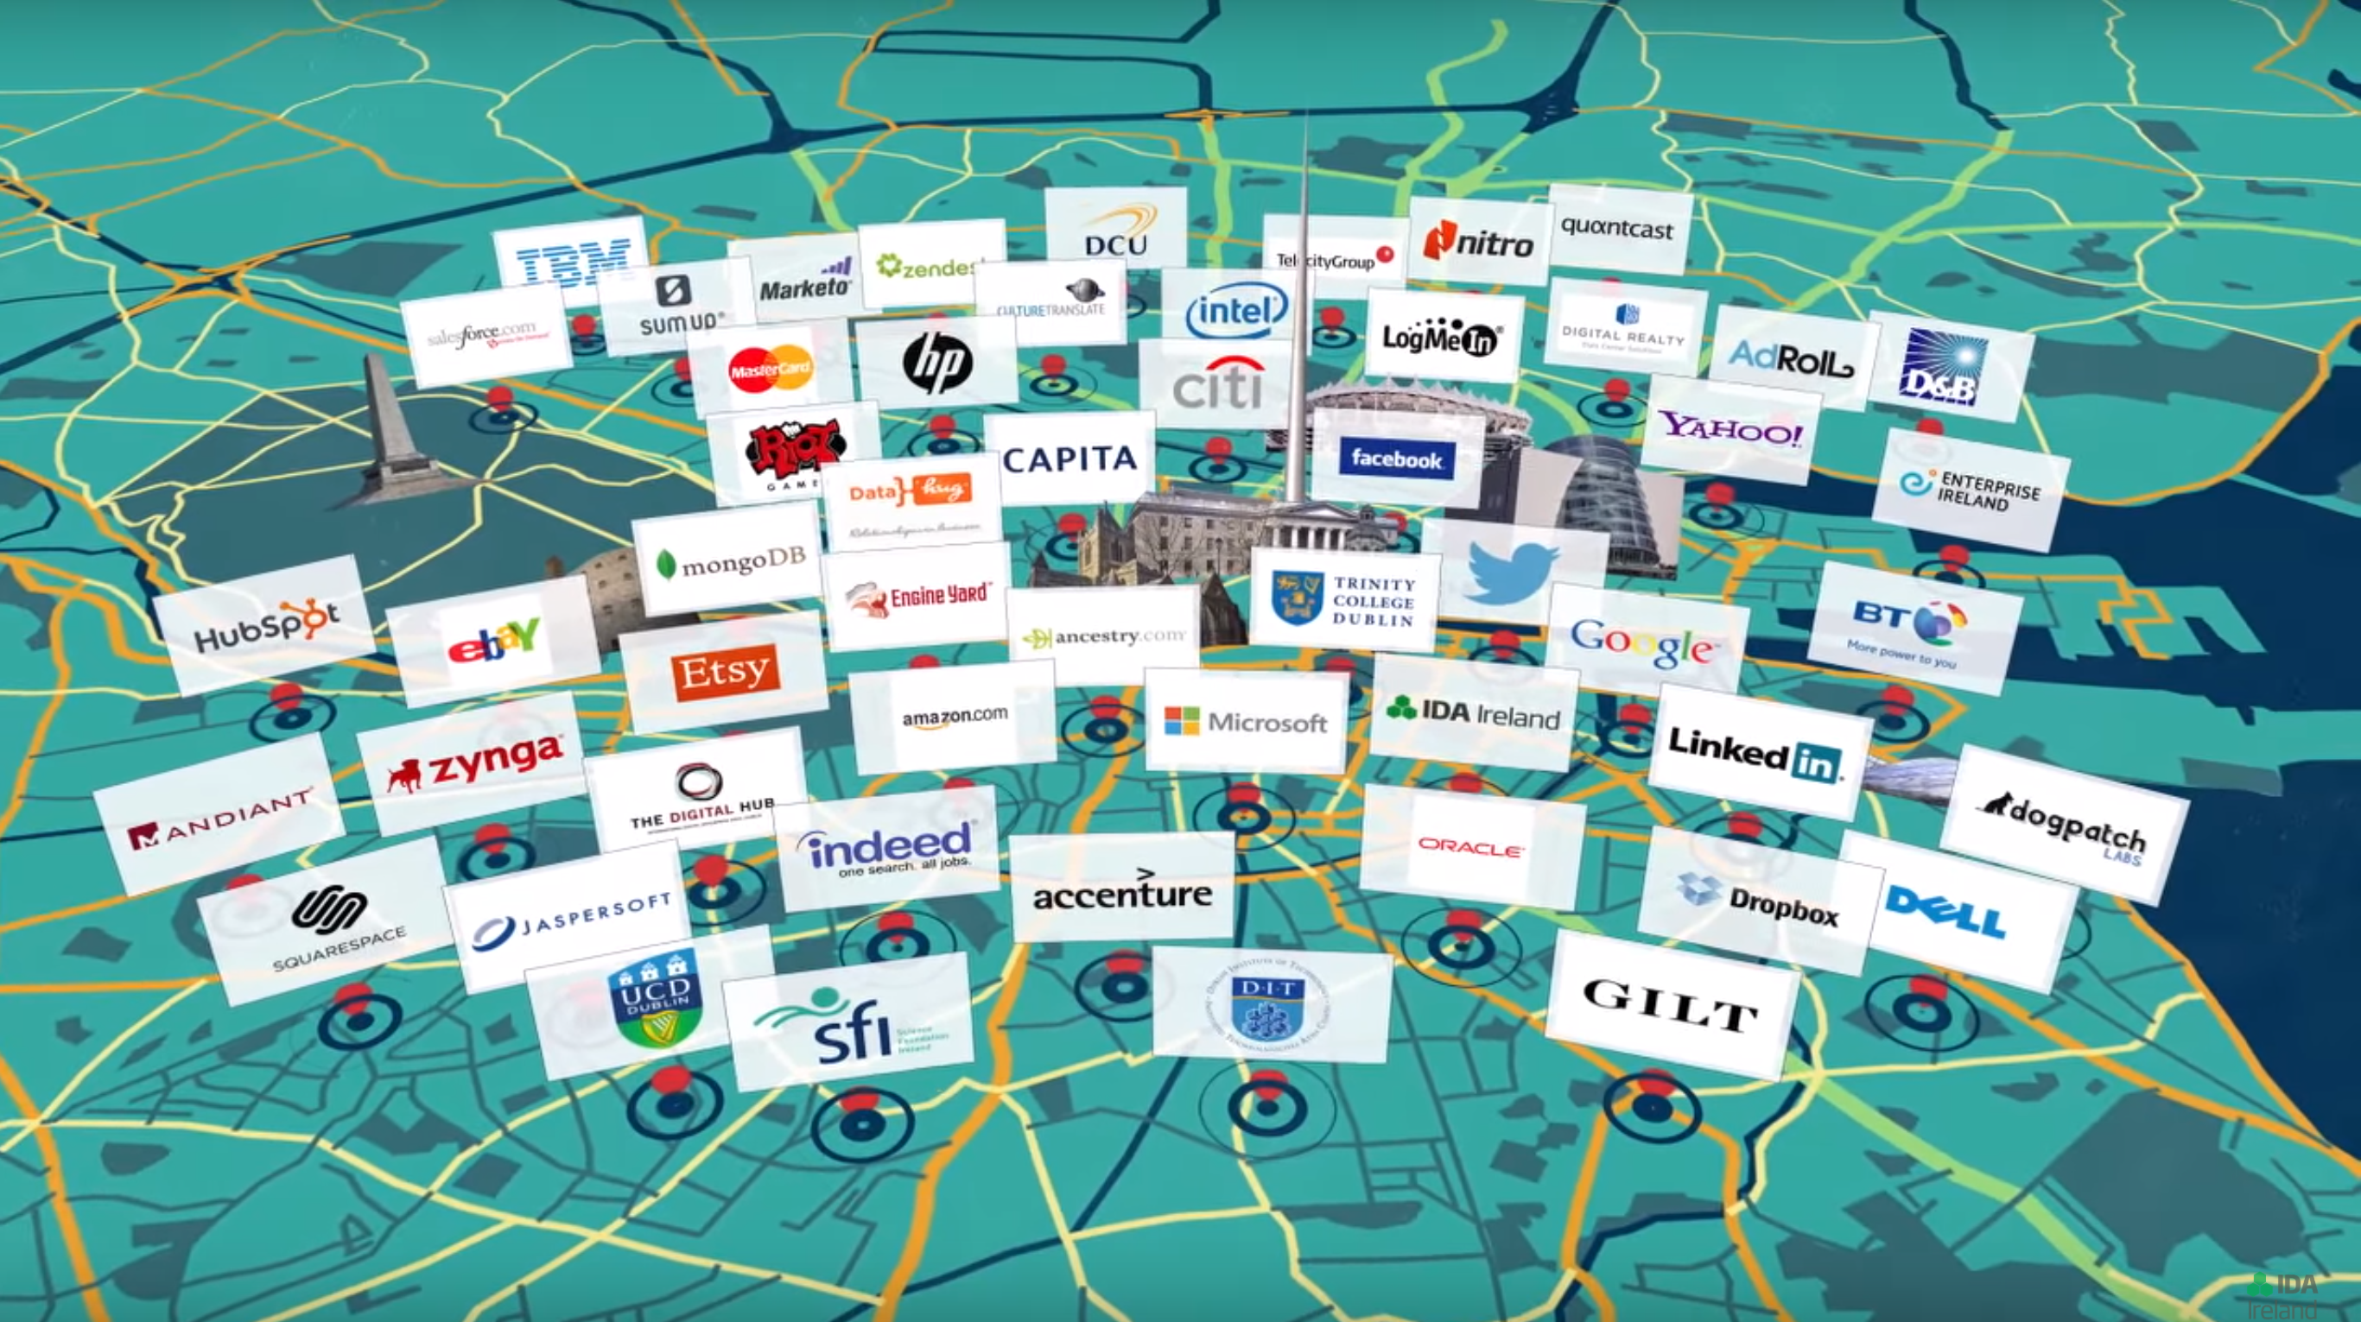
< Dublin’s Tech Hub>
Plain: ABCDEFGHIJKLMNOPQRSTUVWXYZ
Cipher: XYZABCDEFGHIJKLMNOPQRSTUVW
Plaintext: THE QUICK GREEN FOX JUMPS OVER THE LAZY DOG
Ciphertext: QEB NRFZH DOBBK CLU GRJMP LSBO QEB IXWV ALD

Slide 20


Slide 21
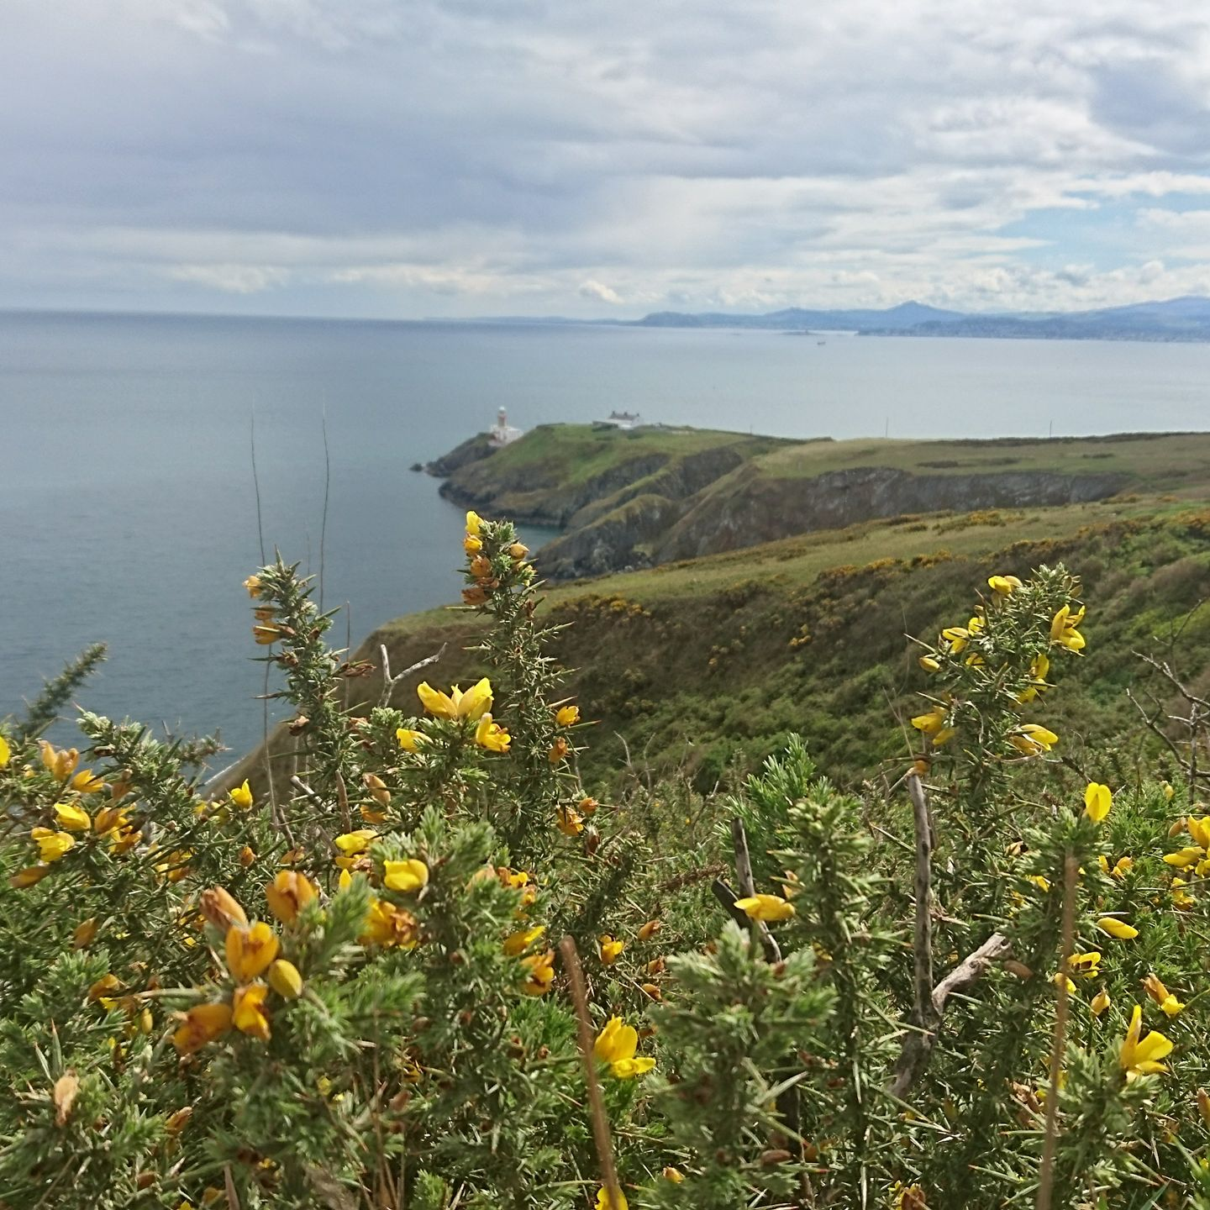
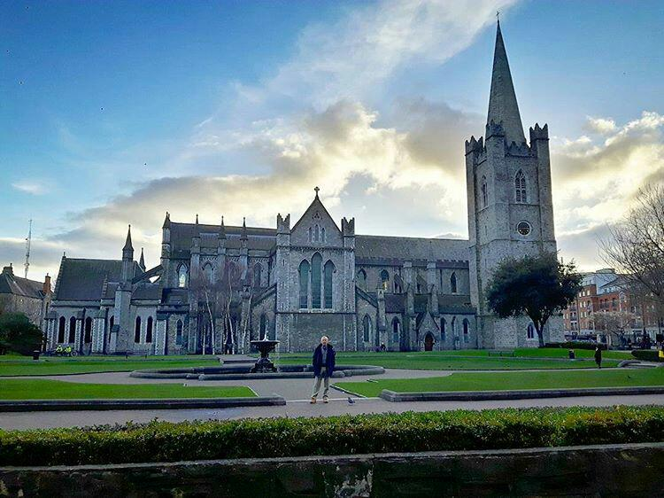
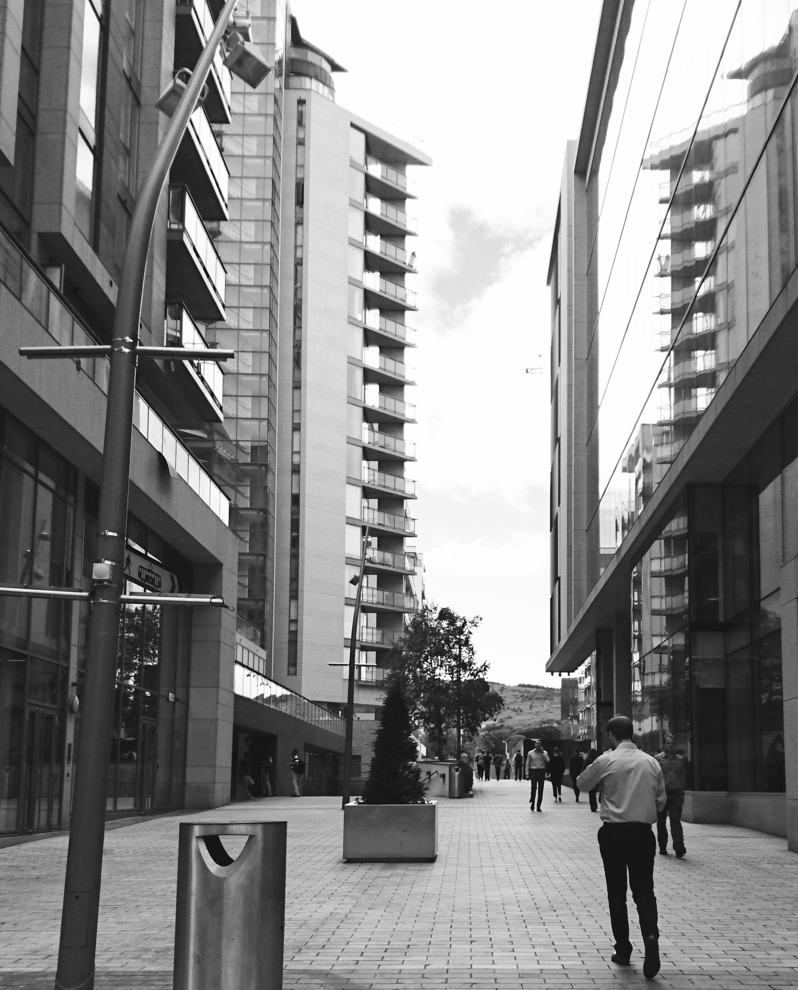

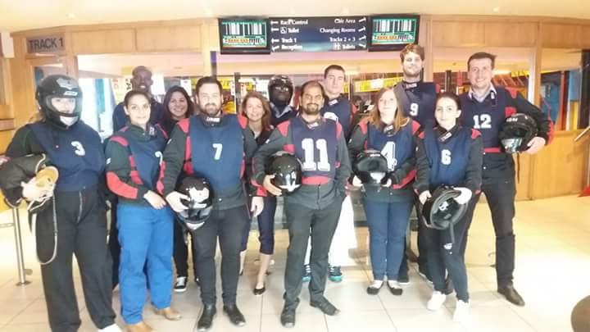

Slide 22

Thank you!
tundecsapo
Tunde Csapo

